Slide 1
CCNA (200-125)
Link State Routing Protocols
Instructor:
Muhammad Naeem
(MSIT/RHCE/CCNP/CCNA/MCSE)
Cell: 0345-5238281
E-Mail: mna571@yahoo.com

Slide 2
Objectives:
Describe the basic features and concepts of Link State Routing Protocols
List the benefits of Link State Routing Protocols
List the requirements of Link State Routing Protocols

Slide 3
Link-State Routing Protocols
Link state protocols creates a complete view or topology of the network by gathering information from all other routers
Link state routing protocols send triggered updates
After the network has converged, a link-state update only sent when there is a change in the topology.
Use Edsger Dijkstra SPF(Shortest Path First) Algorithm
Examples of link state protocols are OSPF and IS-IS

Slide 4
Routers running a link-state routing protocol send information about the state of its links to other routers in the routing domain.
The state of those links refers to its directly connected networks and includes information about the type of network and any neighboring routers on those networks-hence the name link-state routing protocol.
Every router receives all of the link-state information about all other routers in the routing area
With this link-state information
Each router can create its own topological map of the network
Independently calculate the shortest path to every network.

Slide 5
SPF Algorithm
SPF Algorithm accumulates costs along each path, from source to destination
Each router determines its own cost to each destination in the topology
Each router calculates the SPF algorithm and determines the cost from its own perspective
In the diagram, the cost of the shortest path for R2 to send packets to the LAN attached to R3 is 27

Slide 6
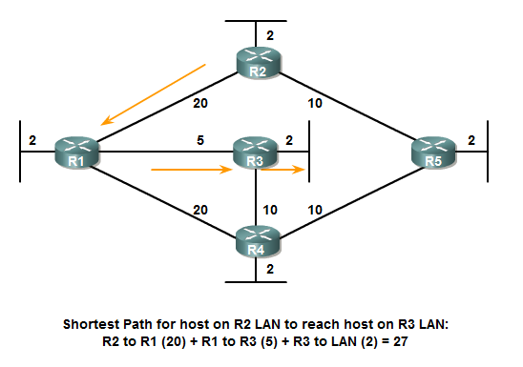

Slide 7
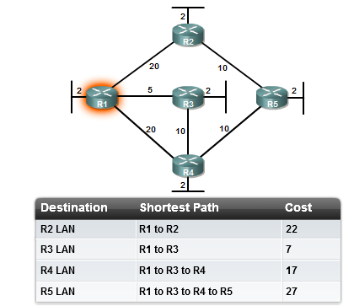
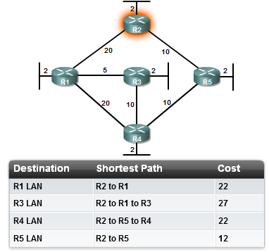

Slide 8
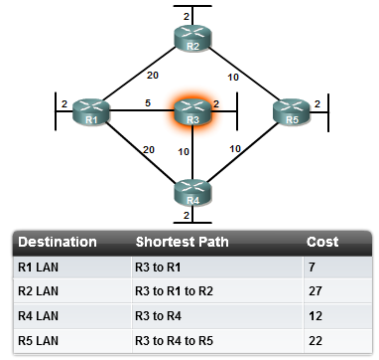
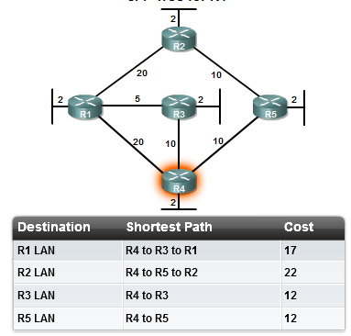

Slide 9
Link State Routing Protocol Process
Each router learns about its own links, its own directly connected networks (interface must be up)
Each router is responsible for discovering and meeting neighbors on directly connected networks(by exchanging Hello packets with other link state routers on directly connected networks).
Each router builds a Link-State Packet (LSP) containing the state of each directly connected link.
This is done by recording all the pertinent information about each neighbor including neighbor ID, link type, and bandwidth.

Slide 10
Each router floods the LSP to all neighbors, who then store all LSPs received in a database.
Neighbors then flood the LSPs to their neighbors until all routers in the area have received the LSPs.
Each router stores a copy of each LSP received from its neighbors in a local database.
Each router uses the database to construct a complete map of the topology and computes the best path to each destination network.
Each router has a complete map of all destinations the routes to reach them.
The SPF algorithm is used to construct the map of the topology and to determine the best path to each network.

Slide 11
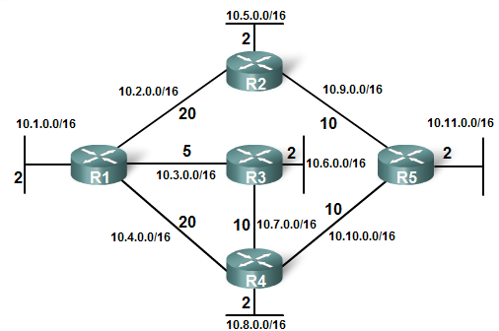
Link State Routing Protocol Process

Slide 12
Link-State information
Information about the state of links is known as link-states information
Link state information includes:
The interface's IP address and subnet mask.
The type of network, such as Ethernet (broadcast) or Serial (point-to-point)
The cost of that link.
Any neighbor routers on that link

Slide 13
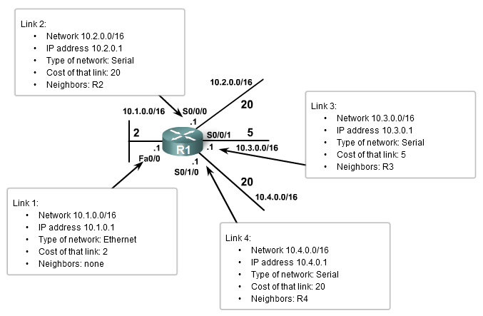

Slide 14
Neighbor Discovery
Each router is responsible for discovering and meeting its neighbors on directly connected networks.
Each router sends Hello packets to discover any neighbor on its link
A neighbor is any other router that is using the same link state routing protocol
When two link state routers learn that they are neighbors, they form adjacency
Hello packets are exchanged at a regular interval between adjacent routers which serve as a “keepalive”
If a routers stops receiving Hello packets from a neighbor, that neighbor is considered as dead, adjacency is broken with that router

Slide 15
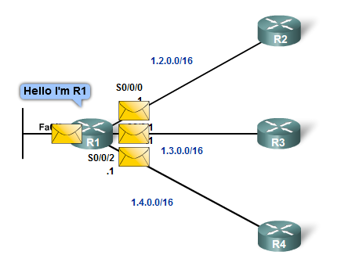
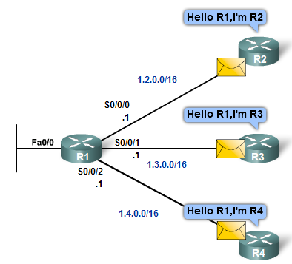
R1 sends Hello packets out its links (interfaces) to discover if there are any neighbors.
R2, R3, and R4 reply to the Hello packet with their own Hello packets because these routers are configured with the same link-state routing protocol.

Slide 16
Link State Packet
Once a router has established its adjacencies, it can build its link-state packets (LSPs)
LSPs contain the link-state information about its links.
In diagram, the LSPs from R1 is:

Slide 17
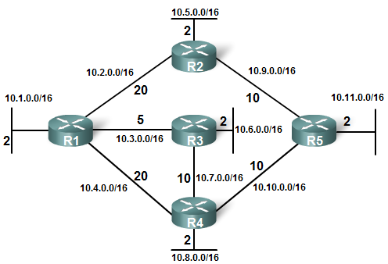
R1; Ethernet network 10.1.0.0/16; Cost 2
R1 -> R2; Serial point-to-point network; 10.2.0.0/16; Cost 20
R1 -> R3; Serial point-to-point network; 10.3.0.0/16; Cost 5
R1 -> R4; Serial point-to-point network; 10.4.0.0/16; Cost 20

Slide 18
LSP Flooding
Each router floods its link-state information to all other link-state routers in the routing area.
Whenever a router receives an LSP from a neighboring router, store it in the local database, and immediately sends that LSP out all other interfaces except the interface that received the LSP.
This process creates a flooding effect of LSPs from all routers throughout the routing area.

Slide 19
An LSP only needs to be sent:
During initial startup of the router or of the routing protocol process on that router
Whenever there is a change in the topology, including a link going down or coming up, or a neighbor adjacency being established or broken

Slide 20
Link State Database Construction
After propagation of each router LSPs, each router has LSP from every link state router
All the LSPs are stored in a database, called Link State Database
Each router runs SPF algorithm to construct the SPF Tree

Slide 21
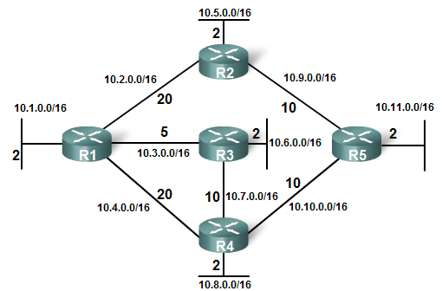

Slide 22
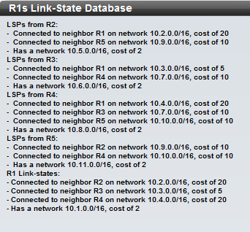
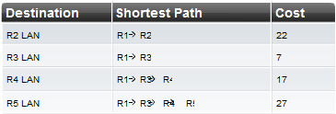

Slide 23
Advantages
Each router builds its own topological map of the network to determine the shortest path
Immediate flooding of LSPs achieves faster convergence
LSPs are sent only when there is a change in the topology
Updates contain only the information regarding the change
Hierarchical design is used when implementing multiple areas

Slide 24
LSR Protocol Requirements(Weakness)
Memory Requirements:
Link-state routing protocols typically require more memory
The memory requirements are due to the use of link-state databases and the creation of the SPF tree.
Processing Requirements:
Link-state protocols can also require more CPU processing
The SPF algorithm requires more CPU time than distance vector algorithms because link-state protocols build a complete map of the topology.
Bandwidth Requirements:
The flooding of link-state packets can adversely affect the available bandwidth on a network

